Slide 1
Message Body Format
Hypermedia Representation

Slide 2
Message Body Format
A REST API commonly uses a response message’s entity body to help convey the state of a request message’s identified resource.
Common responses are in JSON AND XML formats

Slide 3
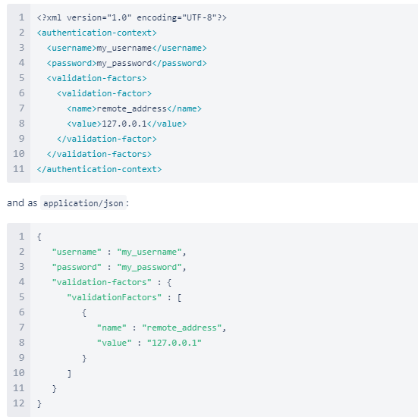
Rule: JSON should be supported for resource representation
Rule: JSON must be well-formed
https://developer.atlassian.com/server/crowd/json-requests-and-responses/

Slide 4
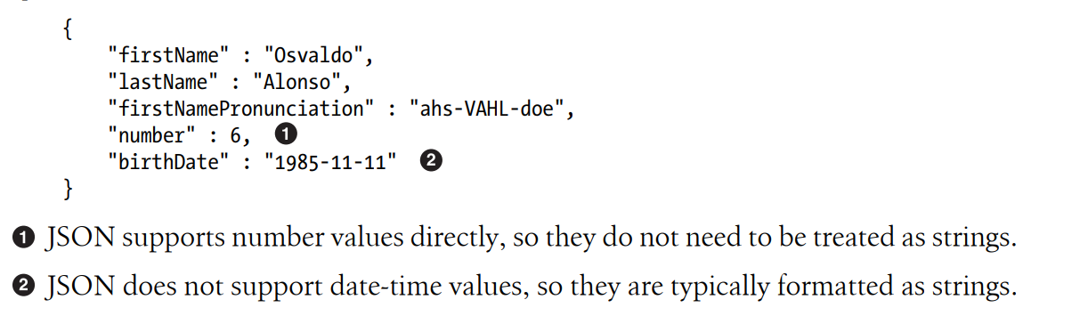
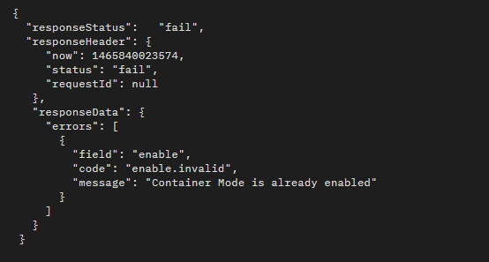
https://www.ibm.com/docs/en/coss/3.10.2?topic=r-json-response-example-127

Slide 5
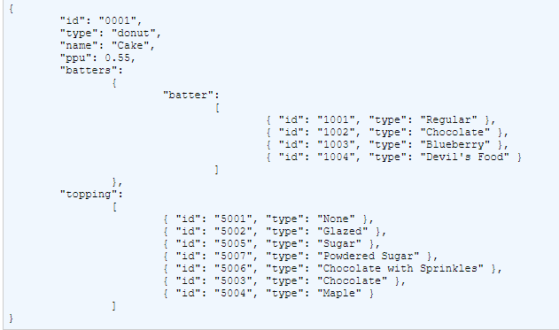
https://drill.apache.org/docs/sample-data-donuts/

Slide 6
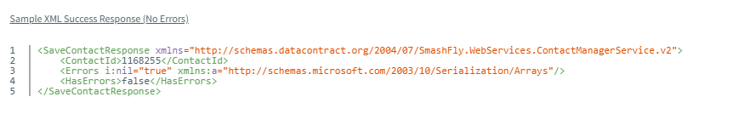
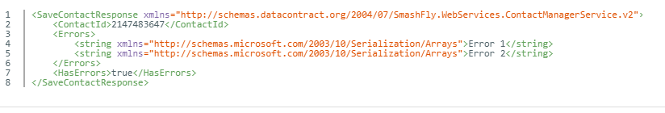
XML EXAMPLES
https://recruit.smashfly.com/SmashFlyHelp/ContactImportAPIHelp/Content/SampleXML.htm

Slide 7
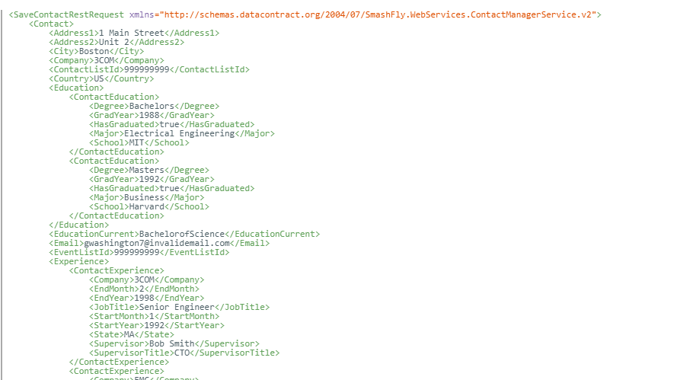
LINK: https://recruit.smashfly.com/SmashFlyHelp/ContactImportAPIHelp/Content/SampleXML.htm

Slide 8
Hypermedia Representation
A REST API response message’s body includes links to indicate the associations and actions that are available for a given resource

Slide 9
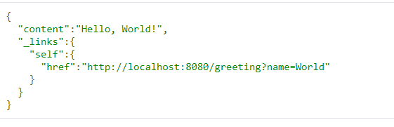
Rule: A consistent form should be used to represent link relations
Rule: A consistent form should be used to advertise links
Rule: A self link should be included in response message body representations
Rule: Links should be used to advertise a resource’s available actions in a state-sensitive manner

Slide 10
